Slide 1


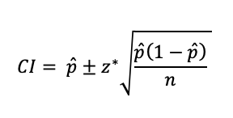


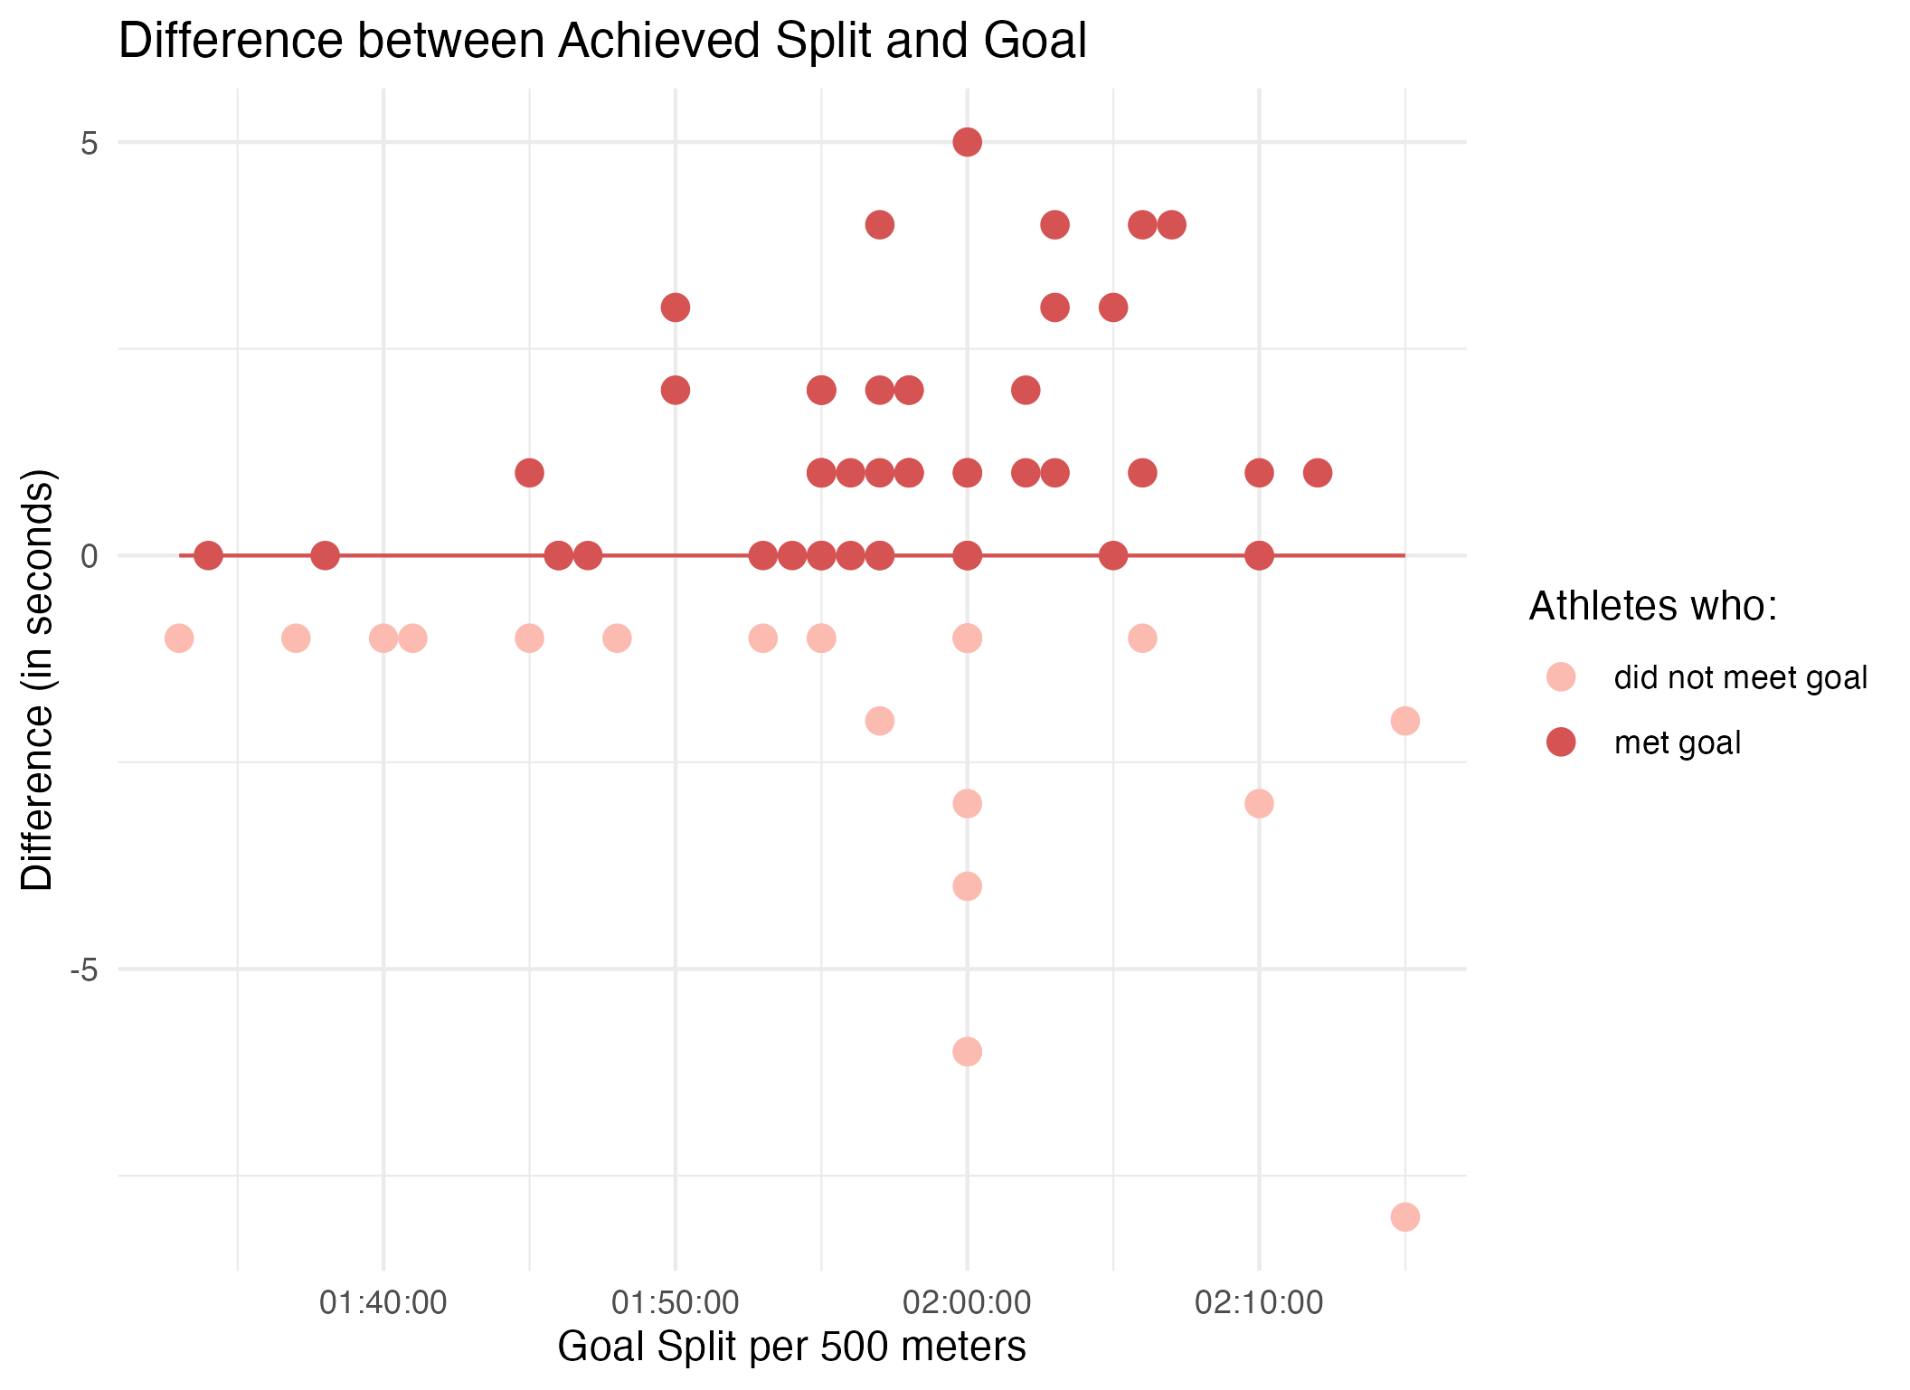
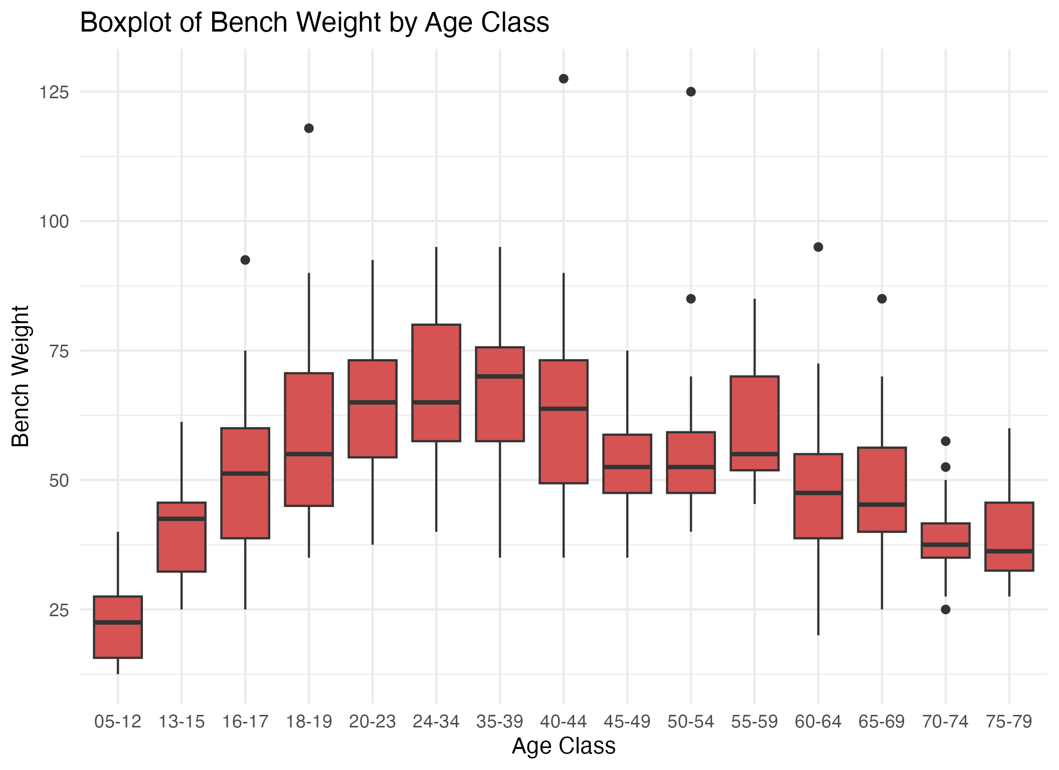
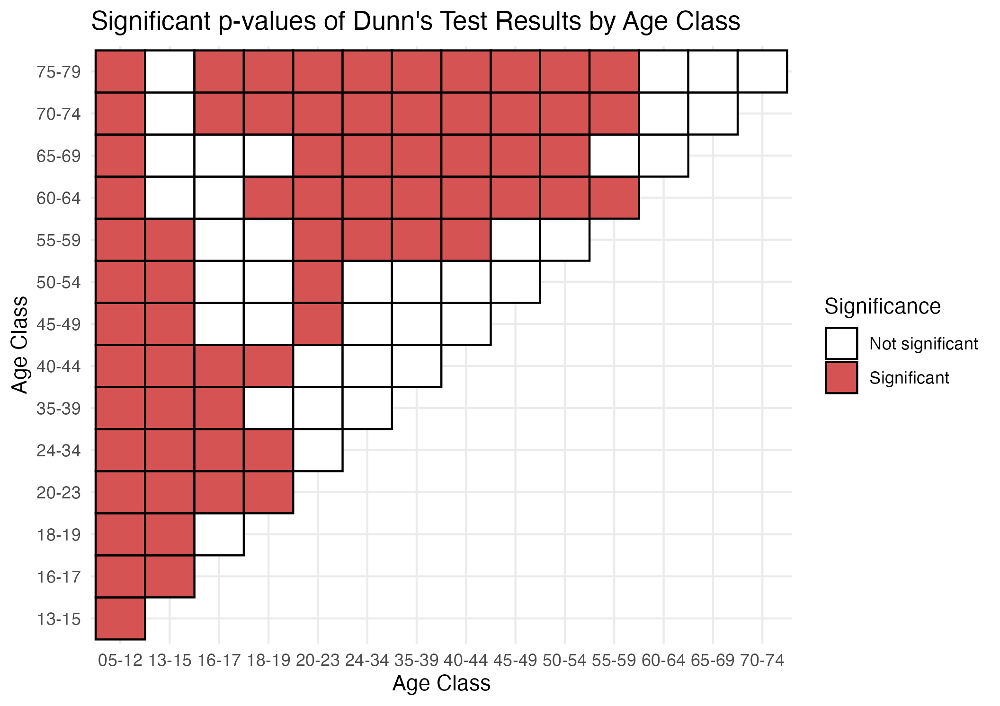

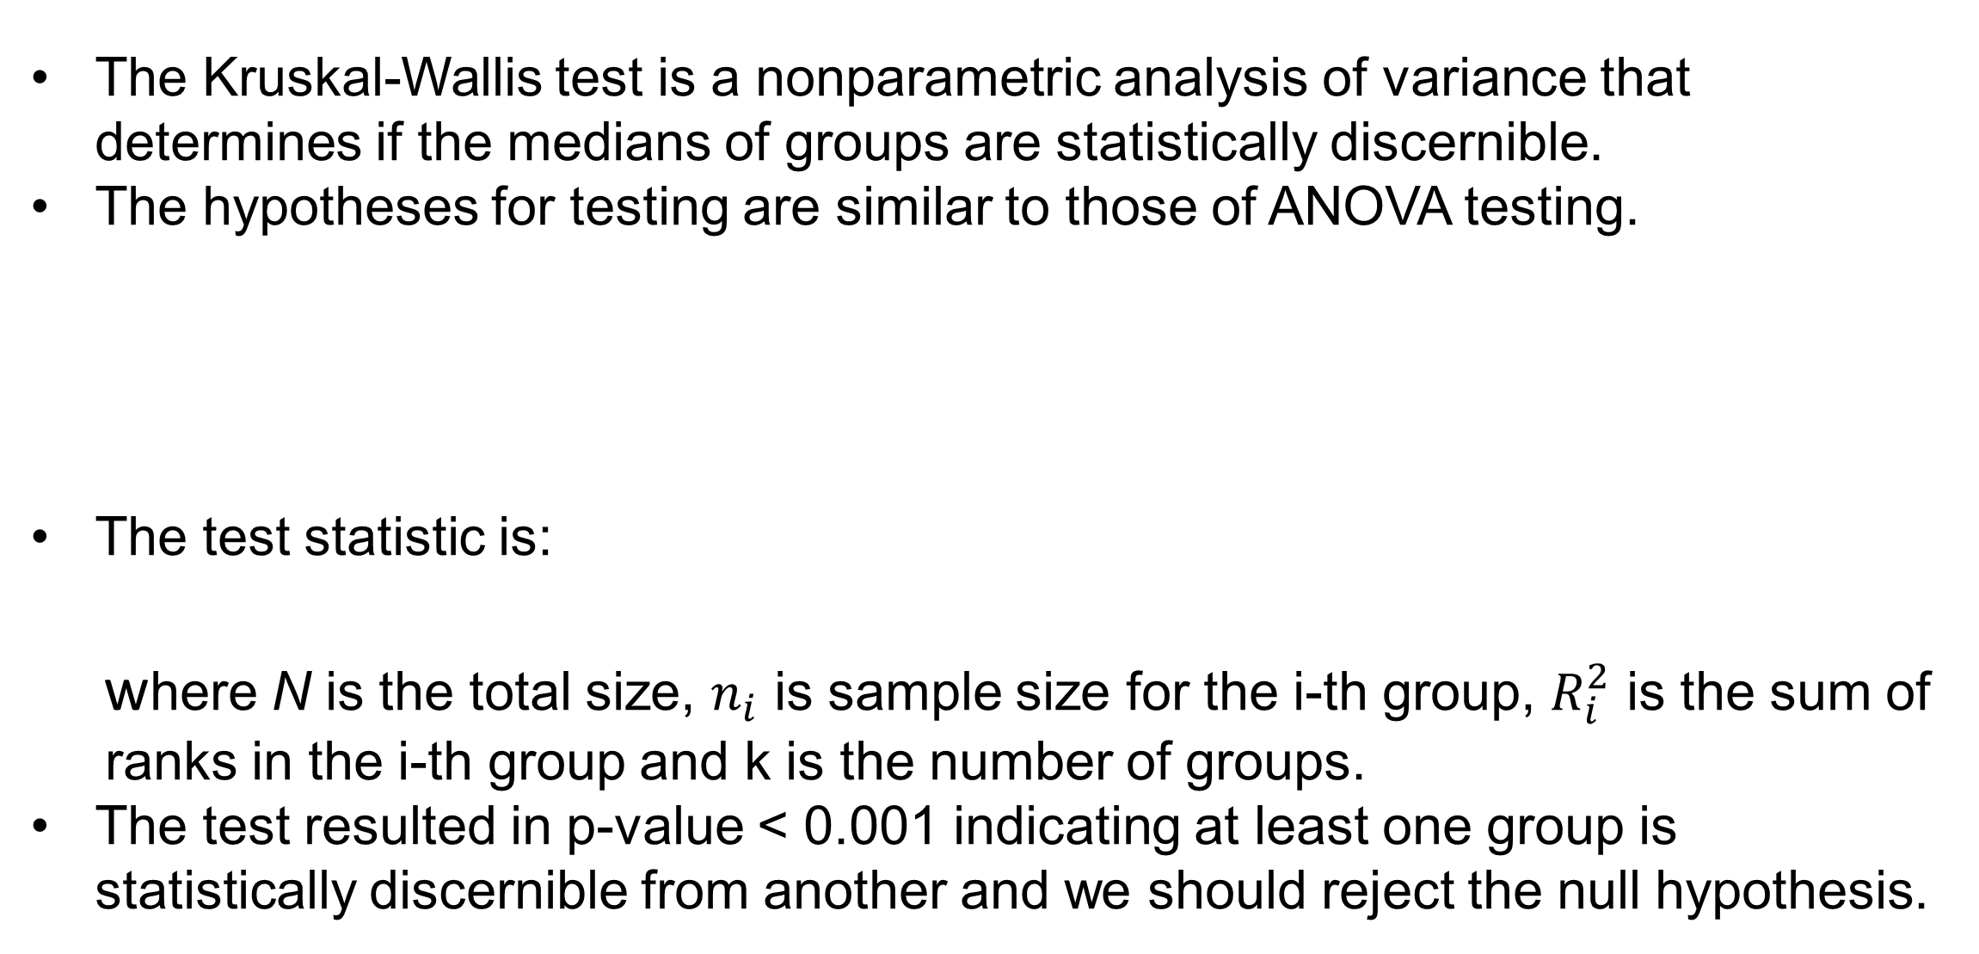
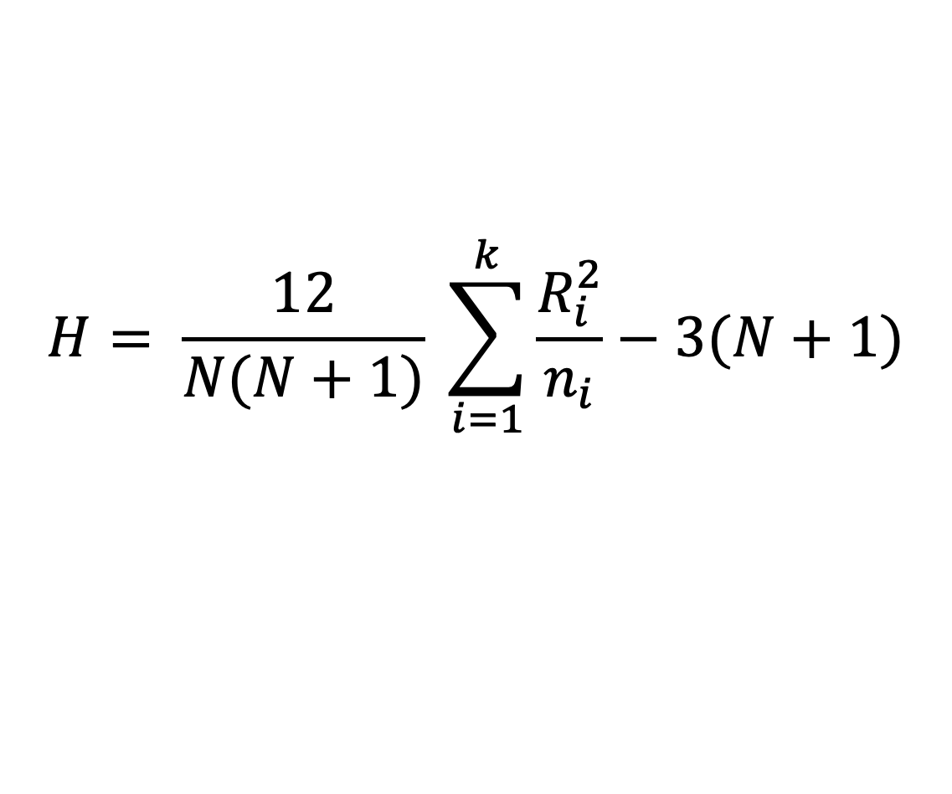
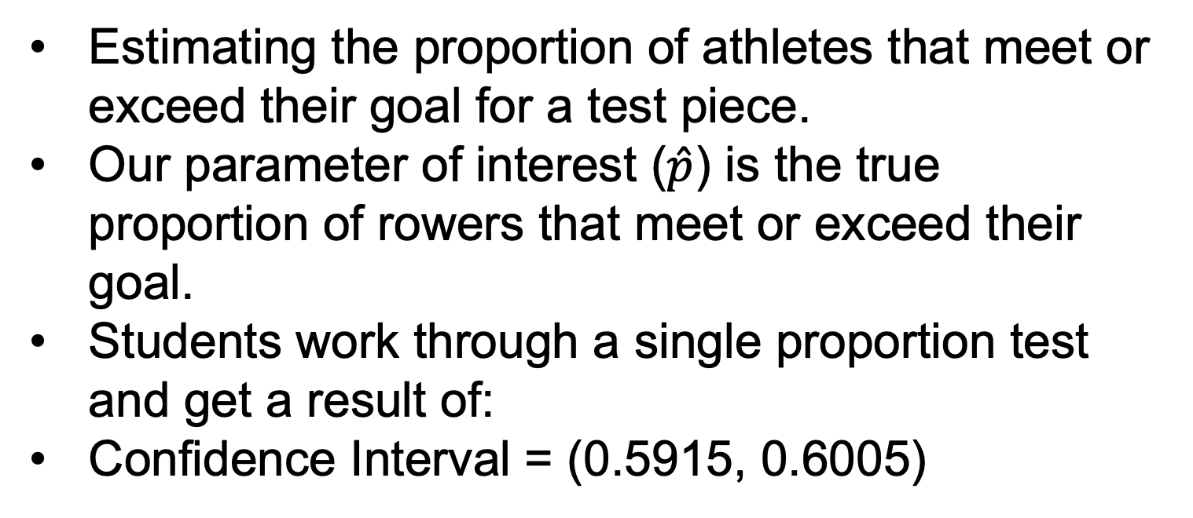
Nonparametric Analysis of Variance and Confidence Intervals
Building Modules for the SCORE Network
Keelin Joyce ‘26
Advised by Dr. Ivan Ramler
Department of Mathematics, Computer Science, and Statistics at St. Lawrence University
Powerlifting Analysis
SCORE Network
Rowing Analysis
Objectives
Determine if the lifting capacity for powerlifters is discernible between age classes.
Run a test of multiple comparison (Dunn’s Test) to determine which groups are statistically discernible from each other.
Create a visualization to easily show the trend in discernibility between age classes.
The SCORE Network is a repository of educational materials for sports statistics and data science including access to modules and data to enhance learning and teaching.
The SCORE Network is funded by the National Science Foundation (NSF).
The module repository has materials for students and teachers that are peer reviewed and published.
Powerlifting
In powerlifting competitions, athletes compete in three compound events (benching, squatting, and deadlifting) to lift as much weight as possible.
This module focuses specifically on female benching weight, but there are extensions for other exercises as well as analyses for males.
The powerlifting module introduces a new form of nonparametric analysis that the SCORE Network was previously lacking.
ANOVA (analysis of variance) is typically used for determining if there is a statistical discernibility between the means of two or more groups but can only be used when the groups are normally distributed.
In this case, the groups are not normally distributed, so the assumptions required to use ANOVA testing are violated and the Kruskal-Wallis test is used.
Due to the skew in the data, the means are not the meaningful metric in this case so the Kruskal-Wallis test uses medians and the ranks of the values instead of the numeric values.
Rowing
During winter training, rowers practice using ergometers (ergs) to maintain and build fitness off of the water.
Ergs share many metrics of fitness including time and duration of the piece and instantly shares the rower’s split (time per 500 meters).
The SCORE Network has a lack of modules for single proportions. This module is aimed at filling that need using confidence intervals of proportions at an introductory level.
The data collected is a current snapshot of the St. Lawrence University rowing team and can be further analyzed with updated data in the future.
Motivation
Prior to completing test pieces to assess their fitness at any given point in the training cycle, rowers are encouraged by their coach to set “ambitious, yet achievable” goals that they aim for
The single proportion confidence interval tells us what proportion of athletes are setting ambitious goals.
Kruskal-Wallis Testing
Confidence Intervals
The Kruskal-Wallis test is a nonparametric analysis of variance that determines if the medians of groups are statistically discernible.
The hypotheses for testing are similar to those of ANOVA testing.
The test statistic is:
where N is the total size, $n_{i}$ is sample size for the i-th group, $R_{i}^{2}$ is the sum of ranks in the i-th group and k is the number of groups.
The test resulted in p-value < 0.001 indicating at least one group is statistically discernible from another and we should reject the null hypothesis.
Estimating the proportion of athletes that meet or exceed their goal for a test piece.
Our parameter of interest ($\hat{p}$) is the true proportion of rowers that meet or exceed their goal.
Students work through a single proportion test and get a result of:
Confidence Interval = (0.5915, 0.6005)
H₀= there is no difference in the median powerlifting weight between age classes.
H_{a} = at least one group differs from another.
$$H= \frac{12}{N(N+1)} \sum_{i=1}^{k}{\frac{R_{i}^{2}}{n_{i}}−3(N+1)}$$
QR Code for Module
QR Code for data
Module Extensions
The scatterplot shows rowers’ goals compared to how far from their goal (rounded in seconds) they achieved on that piece.
The confidence interval and visualization show that many athletes are meeting or exceeding their goals during test pieces, indicating that they should reassess how ambitious their aim is.
We can extend this module to explore more about the type of goal being set.
Dunn’s Multiple Comparison Test
P-values
Because there are 14 groups each being compared with each other, there are too many p-values to easily sort through individual results.
The boxplot and heatmap of significant values show there is a general curved trend in lifting capacity between age classes meaning that there is a peak in performance and then a decline where older and younger groups are not discernible.
Figure 3. Visualization of Distance from Goal Achieved
Discussion
Acknowledgements
Figure 1. Boxplot of Benching Weight by Age Class
Figure 2. Dunn’s Test Results Visualization
This poster explores multiple modules containing different topics of sports statistics and their relevance in learning statistical and data science concepts.
The goal is to design modules on statistical topics that there is a current need for in the network.
I would like to thank Dr. Cathy Crosby and the university’s IRB for their work in approving our methods of data collection.
Thank you to Josh Larson, Phoebe Jones, Cooper Olney, and Faith Rhinehart for wrangling and cleaning the powerlifting data.
Thank you to the St. Lawrence University Crew Team for their time, support, and consent to collect data from their winter training season.
The full module and analysis can be found at the SCORE Network’s preprint module repository

